Slide 1

Video #8
HARDWARE -7
BEGINNER TO EXPERT GUARANTEED
ULTIMATE IT COURSE
ACCESS NETWORKING COURSE PLAYLIST LINK IN DESCRIPTION
SUBSCRIBE!!!

Slide 2
Answers
1. NIC Card Use ? (Gives interface to connect in network using Wired & Wireless)
2. 5 Manufacturers of Graphic Cards ?
3. PCIe Full Form ? (Peripheral Component Interconnect extended)
4. Which has MAC Address ? (WiFi/Bluetooth/NIC/Graphic card)
5. Which Expansion card has HDMI port ? (NIC Card/Audio Card/Graphic Card)
nVIDIA, MSi, Zotac, Asus & AMD
Solve all question and comment down answers...

Slide 3
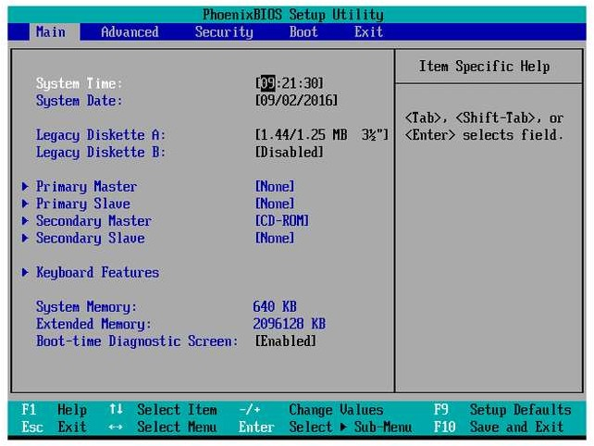
BIOS –Basic Input / Output System
The software used to start your computer
-The firmware
-system BIOS, ROM BIOS
-ROM or flash memory
POST
-Power-On Self-Test
Look for a boot loader
-Start the operating system

Slide 4
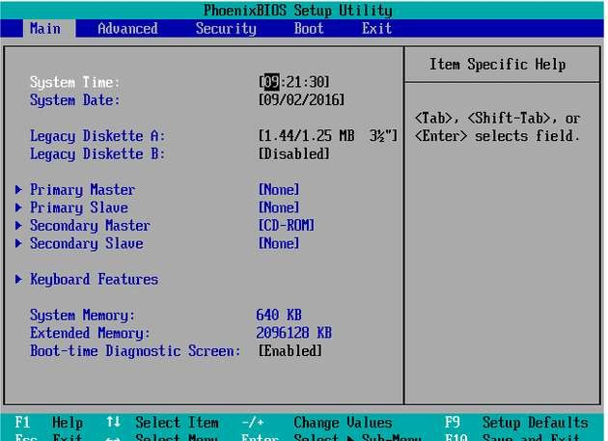
Legacy BIOS
The original / traditional BIOS It’s been around for than 25 years
Older OS talked to hardware through the BIOS
Limited hardware support
No drivers for modern network, video, and storage devices

Slide 5
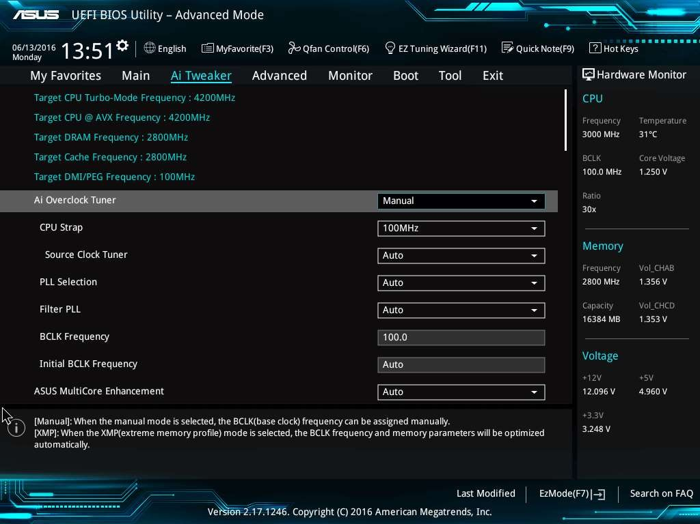
UEFI BIOS
Unified Extensible Firmware Interface
Based on Intel’s EFI (Extensible Firmware Interface)
A defined standard
Implemented by the manufacturers
Designed to replace the legacy BIOS
Need a modern BIOS for modern computers

Slide 6
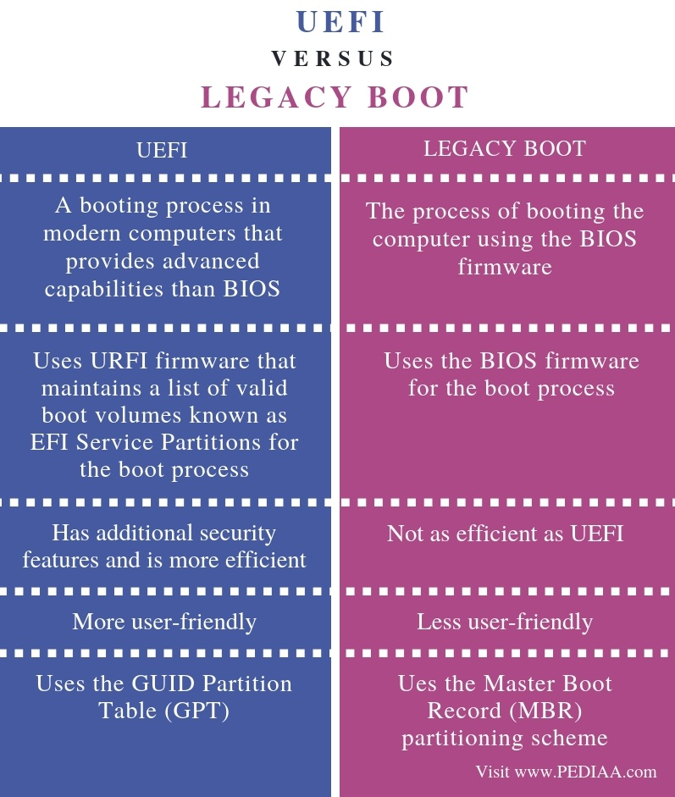

Slide 7
Let’s Explore

Slide 8
Questions:-
1. Abbrevation of UEFI?
2. Which has Mouse Controls? (UEFI BIOS/Legacy BIOS)
3. How to reset BIOS without launching it?
4. How to access BIOS explain Step by Step?
5. 2 differences between Legacy and UEFI?
Solve all question and comment down answers...

